Slide 1
SPA DOGSO
Online-Kurs Talentgruppe FVBJ
13. Juli 2023

Slide 2
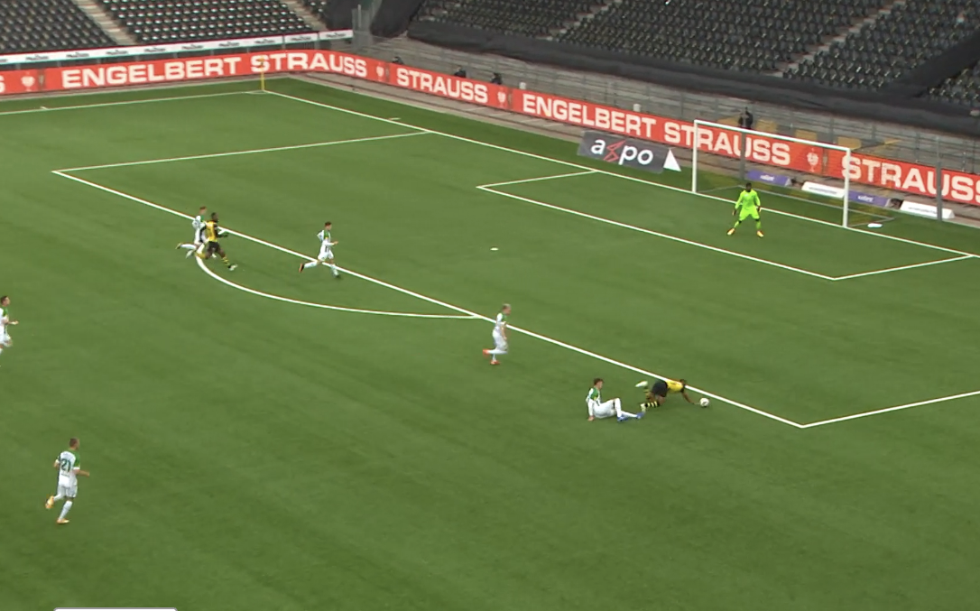
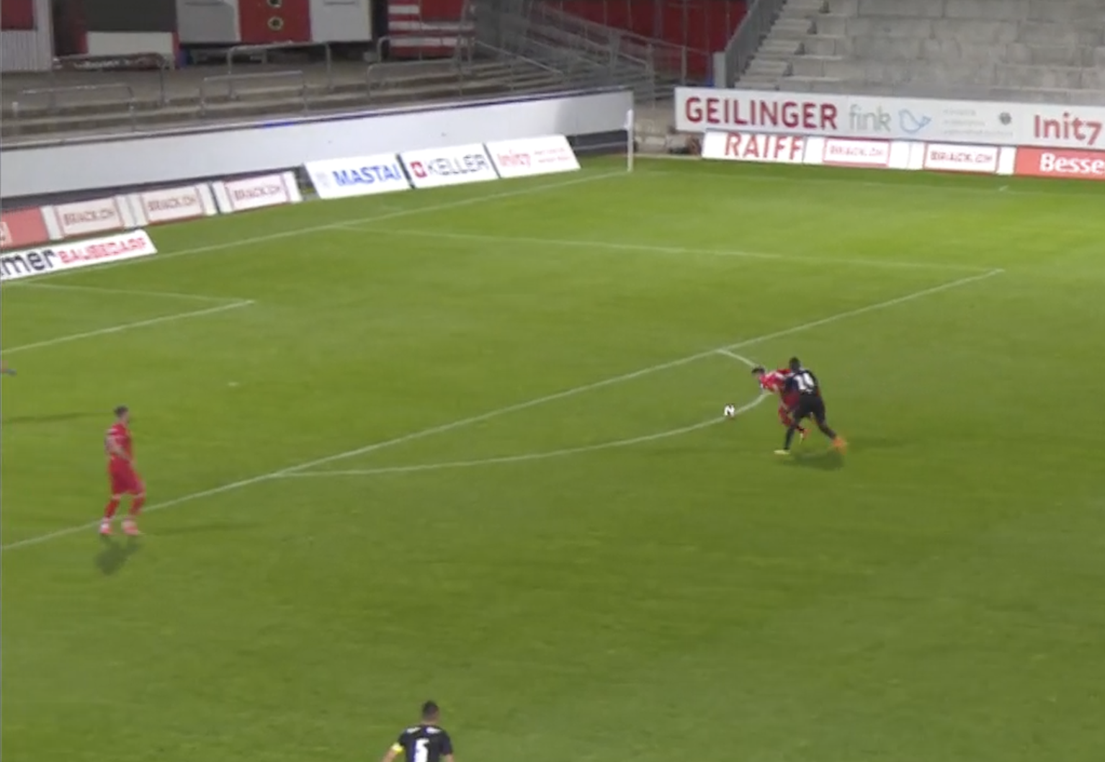
SPA vs. DOGSO
Unterbinden eines aussichtsreichen Angriffs
SPA
Stopping a Promising Attack
Vereiteln einer offensichtlichen Torchance
DOGSO
Denying an Obvious Goal Scoring Opportunity

Slide 3
SPA vs. DOGSO criteria
Distance
Direction
Defenders
Control (Ball)

Slide 4
Inside the penalty area reduction of the disciplinary sanction
TACKLING
HOLDING
TRIPPING
PUSHING
GOALKEEPER WITH HAND
PULLING
HANDBALL

Slide 5
Breakout Rooms
5 Clips
Discuss
Argue

Slide 6
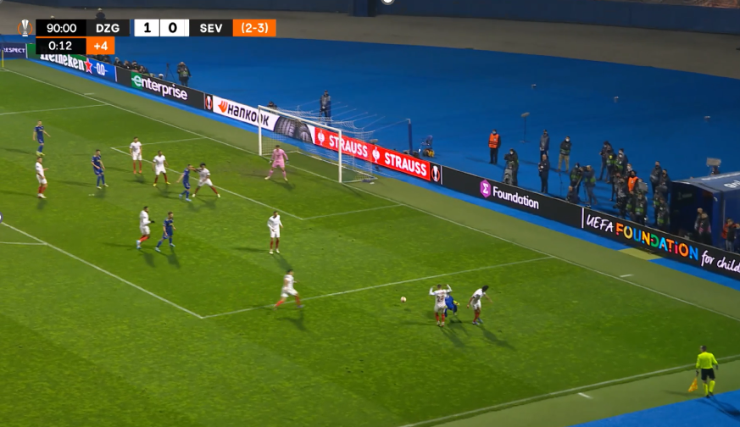
Videotest – Clip B9 RAP-UEFA2022-2: SPA

Slide 7
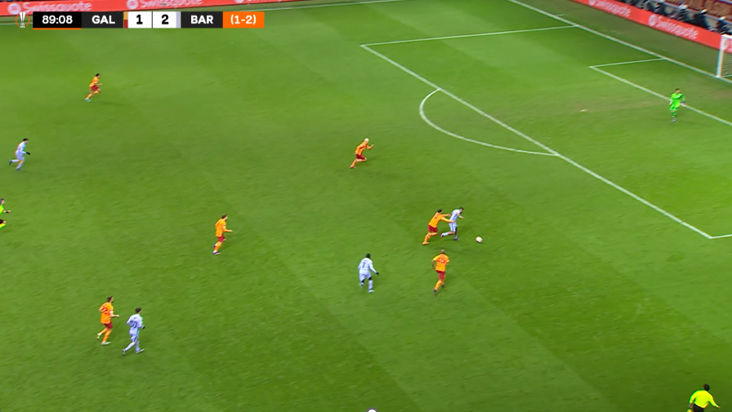
Videotest – Clip B11 RAP-UEFA2022-2: SPA

Slide 8
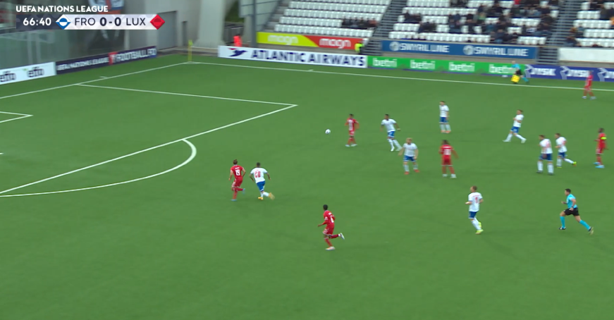
Videotest – Clip B16 RAP-UEFA2022-2: DOGSO

Slide 9
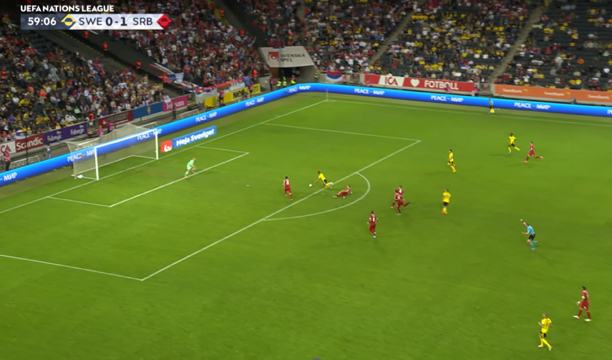
Videotest – Clip B17 RAP-UEFA2022-2: SPA

Slide 10
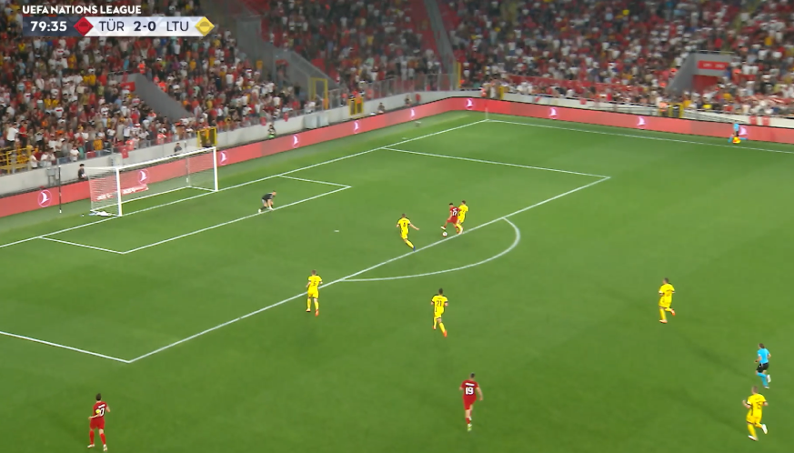
Videotest – Clip B19 RAP-UEFA2022-2: DOGSO (with attempt)

Slide 11
SPA vs. DOGSO
Criterias are important (D D D C)
Attempt to play the ball (one level down)
Be ready
Take charge

Slide 12
SPA vs. Lack of respect
Differences?
Common ground?
Criteria

Slide 13
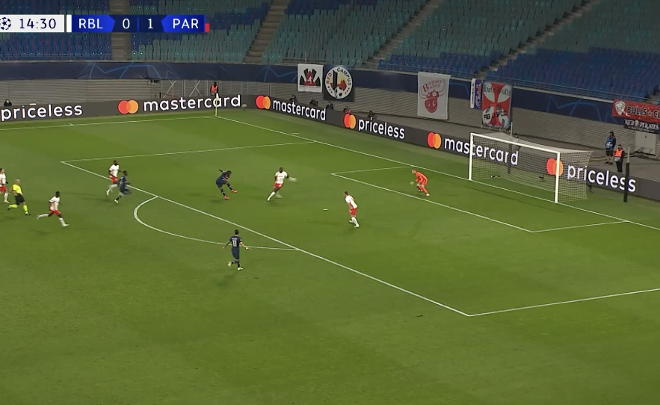
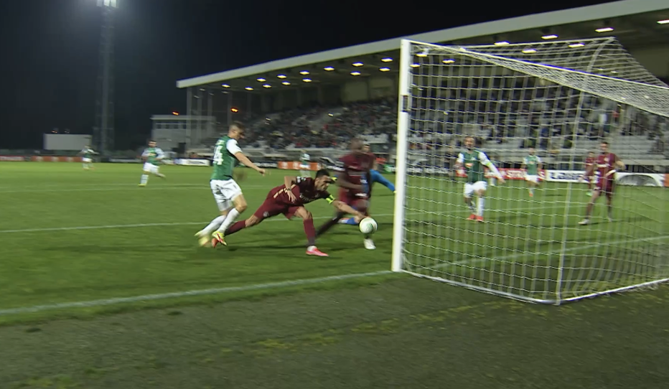
SPA vs. DOGSO – Handball
Goalkeeper in the goal (save possible)
SPA
Goal unattended
DOGSO

Slide 14
Shot on Goal meaning
To be considered as a shot on goal, the direction of the ball should be clearly within the framework of the goal
The results of a shot on goal must be either a safe by the goalkeeper (or by other defender) or a goal by the attacking team
A shot that hits the post or crossbar or goes wide or high or has previously been intercepted by another player is not to be considered as shot on goal

Slide 15
Handball offences PK / DFK and Yellow Card
In some circumstances, the offender should still be cautioned for a handball offence, for example when:
A shot towards the goal is stopped by deliberate (clearly unsporting) handball or
A pass to another attacker is clearly prevented and thus stopped a promising attack.

Slide 16
Conclusions
Stick to the criteria
Focus
BE READY and TAKE CHARGE

Slide 17
Questions

Slide 18
Outlook
KO-Test 15.08.23 in Lyss
Video-Test: Swiss RAP 2023-1 (link on website)

